Slide 1
Eaquals: fostering excellence in international language education
Jo Watson
Eaquals Trustee

Slide 2
What is Eaquals?
An international non-profit membership association for language education professionals, founded in 1991
Our mission is
to help develop excellent standards in language teaching and learning
to support quality in the teaching of any language, in any country and in any education sector
…....We help good language centres to become even better
Notes:
1991 – so nearly 25 but just younger than AVO!
Eaquals standards are (nearly) unique – they apply in all types of language teaching situation – university centres as well as private language schools.
Non profit – means that Eaquals is there to serve its members and the wider language community – and all its funds are used to benefit language education
?Anything about why it was founded – or leave this to Peter?

Slide 3
Eaquals values
Plurilingualism
Intercultural understanding
International cooperation
Lifelong learning
Notes:
Our values are taken from the Council of Europe – the importance of language learning for global citizenship –
Mention our links with the Council of Europe (or leave this to Peter?)
Supports the free movement of people and ideas
Increases understanding between people of different languages and cultures etc

Slide 4
An international community
170 Members
in
37 countries
Teaching
over
25
languages
Notes:
It is important to emphasise the international context in which EAQUALS operates.
EAQUALS members are
Accredited (must undergo an Eaquals inspection) - language providers (teaching centres ) from over 30 countries both inside and outside the European union.
Language course providers are by their nature international organisations and being part of an organisation that reaches out to and brings together this many countries means gaining an insight (academic and non, both linguistic and non) into what is happening across the language education sector

Slide 5
A network of experts
Associate Members
National quality associations
Cultural organisations
Examination providers
Educational publishers
Notes:
Associate members –
Many countries have their own prominent accreditation organisations or national bodies for quality control of language course provision. EAQUALS counts among its members:
12 national accreditation schemes/associations - we have helped to influence and develop their schemes (and they ours)
Also national bodies that promote their language and culture …etc etc
EAQUALS brings these bodies together to create a unique network of experts – they work with our accredited schools to….

Slide 6
Working to raise standards
Accreditation of language centres – inspections to high international standards protect learners
Consultancy and training – to help good schools become even better
International conferences and workshops to share expertise
Projects to develop new practical teaching resources
Educational work in partnership with national and international bodies – Council of Europe, ALTE, ISO …
Notes:
Some examples of how we work and what we do …ollaboration with national and international bodies
EAQUALS has participatory status with the Council of Europe, and has worked closely with its Language Policy Division on developments related to the Common European Framework of Reference, the European Language Portfolio, and language provision for adult migrants.
EAQUALS and ALTE The Association of Language Testers in Europe co-operated to develop the EAQUALS-ALTE European Language Portfolio (ELP)
EAQUALS and JAMOTE Japan Association for Management of Training and Education have worked closely together on the development of ISO 29990, a new standard for providers of learning services in the non-formal sector.

Slide 7
Our expertise & influence
Quality assurance
& management
The Common European Framework of Reference for Languages (CEFR)
Academic management and professional development
design of quality schemes
capacity building at local & national level
course design
assessment and certificates
competence frameworks
teacher training and development
Notes:
Helping language centres and language teachers in practical ways
Helping countries and national associations to develop their own QA schemes
Helping define the skills all language teachers need – not just for English but for any language

Slide 8
What does this mean for you?
Take part in the international world of language education
Share expertise with international experts and professionals who care about quality
Form partnerships
Get involved in cross-border projects
Practical support for your events

Slide 9
Resources on our website
Applying the CEFR in your classrooms
Level descriptors
Training materials
Course design and assessment packs
Supporting in-service teacher development
European Profiling Grid and eGrid
Eaquals Framework for Language Teacher Training & Development
www.eaquals.org/our-expertise/
Notes:
Mention CPD scheme

Slide 10
Eaquals International Conferences
Join us in 2018
26 – 28 April
in Prague

Slide 11
Working in partnership to benefit the language education community
EU-funded projects: European Profiling Grid, Quality Guidelines
Core Inventory for General English (with the British Council)
With the Council of Europe: work to support the linguistic integration of adult migrants
With ISO: developing new standards for providers of learning services and language learning services
With ALTE: the Eaquals-ALTE electronic language portfolio
Notes:
Some examples of work we have done to develop resources for everyone to use and to raise quality standards in teaching centres that are not Eaquals members.

Slide 12
Eaquals accreditation – more than another inspection!

Slide 13
So how do you feel about quality audits?

Slide 14
Eaquals accreditation – values and approach
Multilingual
Partnership – practical help and advice to prepare
Benchmarks – your objectives as well as Eaquals standards
Feedback and recommendations from experienced experts
Support for further development

Slide 15
The Quality Cycle – a positive approach
School self-assessment
External inspection (by peers)
Recommendations for further improvement
Post inspection follow-up
School implements new developments
New initiatives & developments

Slide 16
Evaluating the whole ‘school in action’
Management & administration
Course design & assessment
Classroom teaching
Internal quality assurance
Learning resources & premises
Student welfare & services
Fair dealing

Slide 17
Support for applicants
Self Assessment – an internal benchmarking exercise
How well does my institution meet the Eaquals standards?
Feedback from the Director of Accreditation
Advisory Site Visit and/or desk review
What do I need to improve to meet the standards?
Review by Eaquals inspectors + feedback, advice and a written report
Prepare for an inspection
Develop and implement systems and processes.
Advice from Director of Accreditation, and extra training if required
Apply for an inspection
Printed resources: Guide for Institutions and Inspection Manual

Slide 18
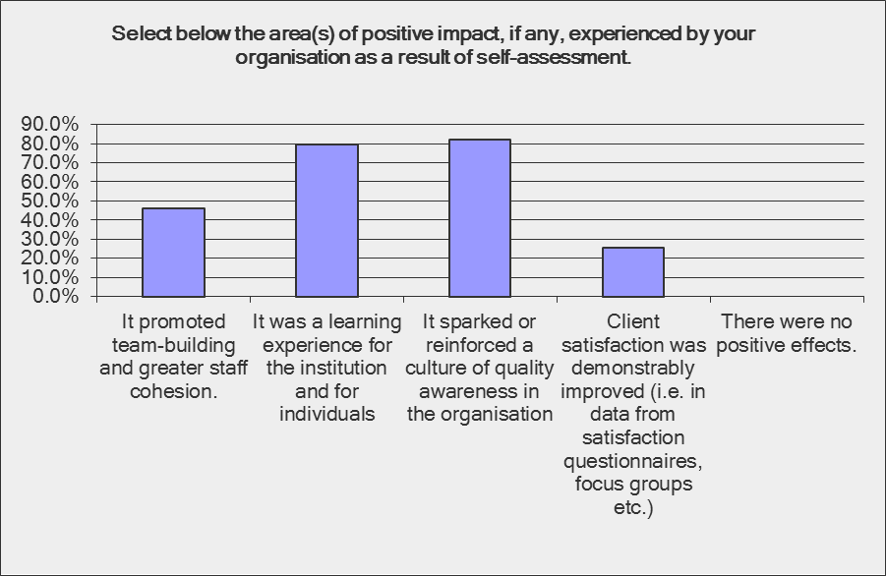
Eaquals survey on self-assessment

Slide 19
Why use Eaquals accreditation services?
To help you to stand out
To show that you meet international standards
To receive independent advice and support from international experts
To provide you with a road map for future development

Slide 20
Is quality good for business?

Slide 21
Quality? Why bother?
Our learners need good language skills
Professional pride in our work
A people business – word-of-mouth recommendations and repeat business
Valued and engaged staff increase your profits – learning organisations (Macleod 2009)
A challenge – to deliver high quality at sensible costs

Slide 22
Eaquals International Conference 26– 28 April 2018 Corinthia Hotel, Prague

Slide 23
Find out more at:
www.eaquals.org
info@eaquals.org
director@eaquals.org

